Slide 1
Chapter 5: Process Synchronization

Slide 2
Interprocess Communication
Processes within a system may be independent or cooperating
Cooperating process can affect or be affected by other processes, including sharing data
Reasons for cooperating processes:
Information sharing
Computation speedup
Modularity
Convenience
Cooperating processes need interprocess communication (IPC)
Two models of IPC
Shared memory
Message passing

Slide 3
Communications Models
(a) Message passing. (b) shared memory.

Slide 4
Interprocess Communication – Shared Memory
An area of memory shared among the processes that wish to communicate
The communication is under the control of the users processes not the operating system.
Major issues is to provide mechanism that will allow the user processes to synchronize their actions when they access shared memory.

Slide 5
Interprocess Communication – Message Passing
Mechanism for processes to communicate and to synchronize their actions
Message system – processes communicate with each other without resorting to shared variables
IPC facility provides two operations:
send(message)
receive(message)
The message size is either fixed or variable

Slide 6
Producer-Consumer Problem
Paradigm for cooperating processes, producer process produces information that is consumed by a consumer process
unbounded-buffer places no practical limit on the size of the buffer
bounded-buffer assumes that there is a fixed buffer size

Slide 7
Producer
while (true) { /* produce an item in next produced */
while (counter == BUFFER_SIZE) ;
/* do nothing */
buffer[in] = next_produced;
in = (in + 1) % BUFFER_SIZE;
counter++;
}

Slide 8
Consumer
while (true) {
while (counter == 0)
; /* do nothing */
next_consumed = buffer[out];
out = (out + 1) % BUFFER_SIZE;
counter--;
/* consume the item in next consumed */
}

Slide 9
Race Condition
counter++ could be implemented as register1 = counter register1 = register1 + 1 counter = register1
counter-- could be implemented as register2 = counter register2 = register2 - 1 counter = register2
Consider this execution interleaving with “count = 5” initially:
S0: producer execute register1 = counter {register1 = 5} S1: producer execute register1 = register1 + 1 {register1 = 6} S2: consumer execute register2 = counter {register2 = 5} S3: consumer execute register2 = register2 – 1 {register2 = 4} S4: producer execute counter = register1 {counter = 6 } S5: consumer execute counter = register2 {counter = 4}

Slide 10
Critical Section Problem
Consider system of n processes {p₀, p₁, … p_{n-1}}
Each process has critical section segment of code
Process may be changing common variables, updating table, writing file, etc
When one process in critical section, no other may be in its critical section
Critical section problem is to design protocol to solve this
Each process must ask permission to enter critical section in entry section, may follow critical section with exit section, then remainder section

Slide 11
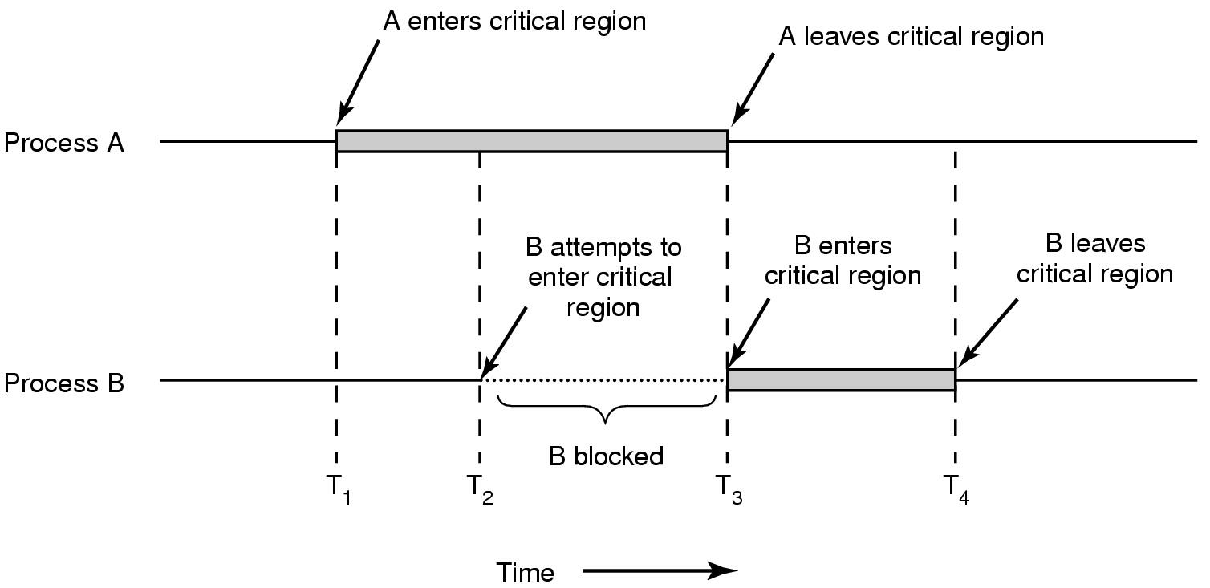
Critical Section

Slide 12
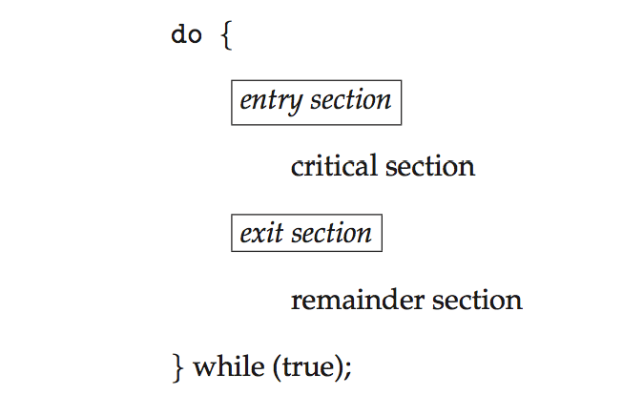
Critical Section
General structure of process P_{i}

Slide 13
Solution to Critical-Section Problem
1. Mutual Exclusion - If process P_{i} is executing in its critical section, then no other processes can be executing in their critical sections
2. Progress - If no process is executing in its critical section and there exist some processes that wish to enter their critical section, then the selection of the processes that will enter the critical section next cannot be postponed indefinitely
3. Bounded Waiting - A bound must exist on the number of times that other processes are allowed to enter their critical sections after a process has made a request to enter its critical section and before that request is granted
Assume that each process executes at a nonzero speed
No assumption concerning relative speed of the n processes

Slide 14
Synchronization Hardware
Possible solutions:
Disabling Interrupts
Lock Variables
Strict Alternation
Test and Set Lock
Peterson’s solution

Slide 15
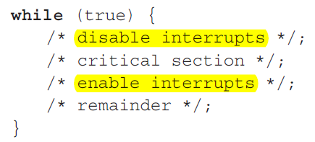
Disabling Interrupts
How does it work?
Disable all interrupts just after entering a critical section
Re-enable them just before leaving it.
Why does it work?
With interrupts disabled, no clock interrupts can occur
No switching can occur
Problems:
What if the process forgets to enable the interrupts?
Multiprocessor? (disabling interrupts only affects one CPU)

Slide 16
Lock Variable Method
int lock = 0;
while (lock !=0);
lock = 1;
//EnterCriticalSection;
access shared variable;
//LeaveCriticalSection;
lock = 0;

Slide 17
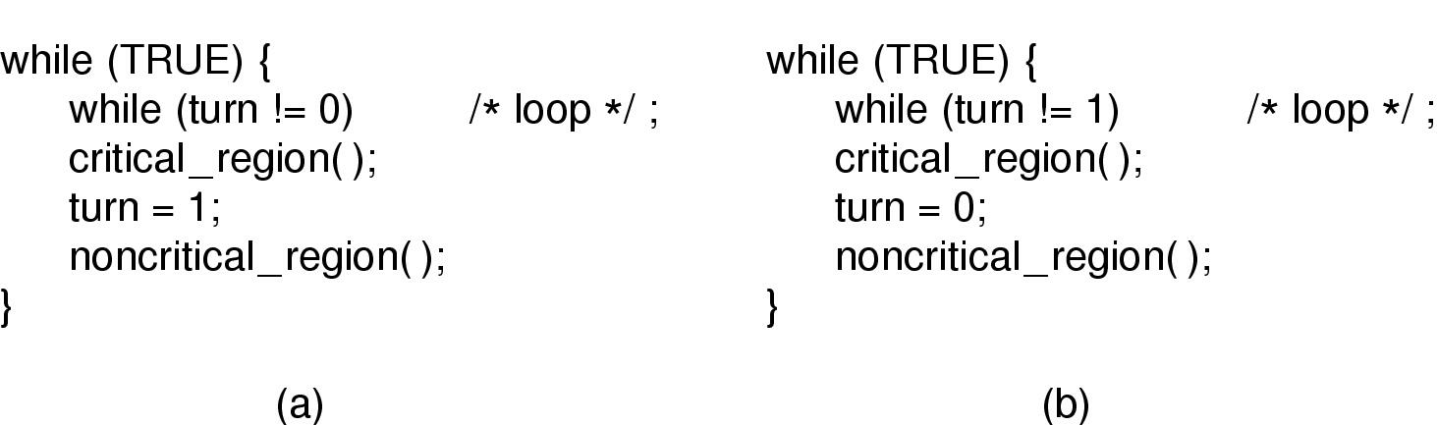
Strict Alternation
initially turn=0

Slide 18
Problems
Busy waiting: Continuously testing a variable until some value appear
Wastes CPU time
Violates progress
When one process is much slower than the other

Slide 19
Peterson's solution
Consists of 2 procedures
Each process has to call
enter_region with its own process # before entering its C.R.
And Leave_region after leaving C.R.

Slide 20
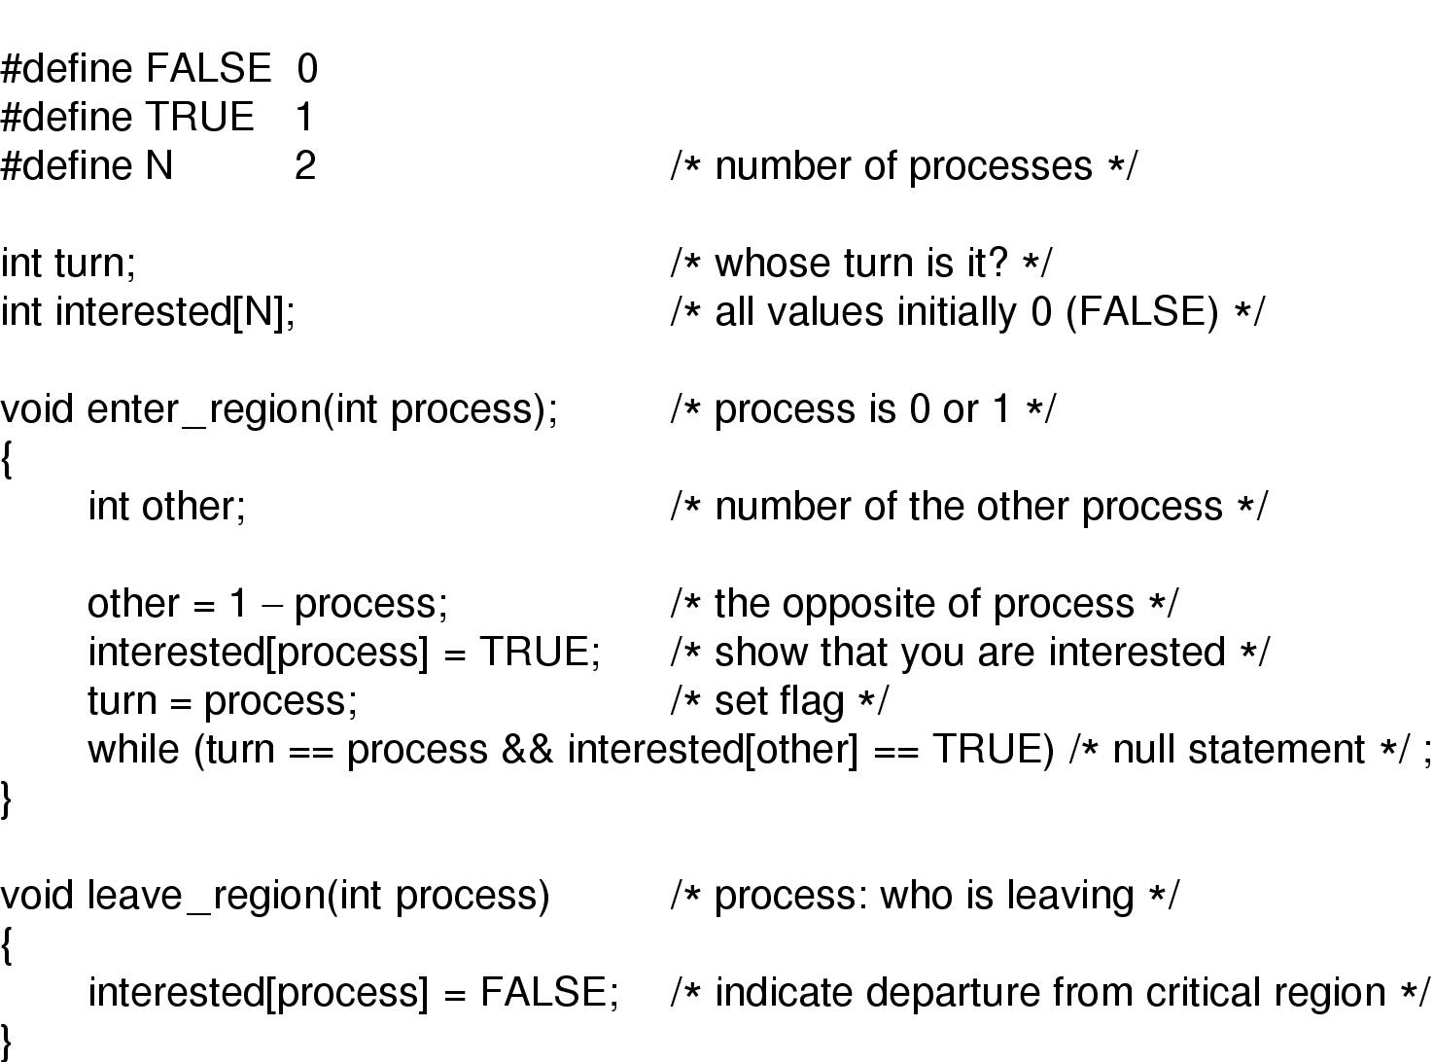
Peterson's solution (for 2 processes)

Slide 21
Peterson’s Solution: Analysis(1)
Let Process 1 is not interested and Process 0 calls enter_region with 0
So, turn = 0 and interested[0] = true and Process 0 is in CR
Now if Process 1 calls enter_region, it will hang there until interested[0] is false. Which only happens when Process 0 calls leave_region i.e. leaves the C.R.

Slide 22
Peterson’s Solution: Analysis(2)
Let both processes call enter_region simultaneously
Say turn = 1. (i.e. Process 1 stores last)
Process 0 enters critical region: while (turn = = 0 && …) returns false since turn = 1.
Process 1 loops until process 0 exits: while (turn = = 1 && interested[0] = = true) returns true.

Slide 23
Sleep & wakeup
When a process has to wait, change its state to BLOCKED/WAITING
Switched to READY state, when it is OK to retry entering the critical section
Sleep is a system call that causes the caller to block
be suspended until another process wakes it up
Wakeup system call has one parameter, the process to be awakened.

Slide 24
Producer Consumer Problem
Also called bounded-buffer problem
Two (m+n) processes share a common buffer
One (m) of them is (are) producer(s): put(s) information in the buffer
One (n) of them is (are) consumer(s): take(s) information out of the buffer
Trouble and solution
Producer wants to put but buffer full- Go to sleep and wake up when consumer takes one or more
Consumer wants to take but buffer empty- go to sleep and wake up when producer puts one or more

Slide 25
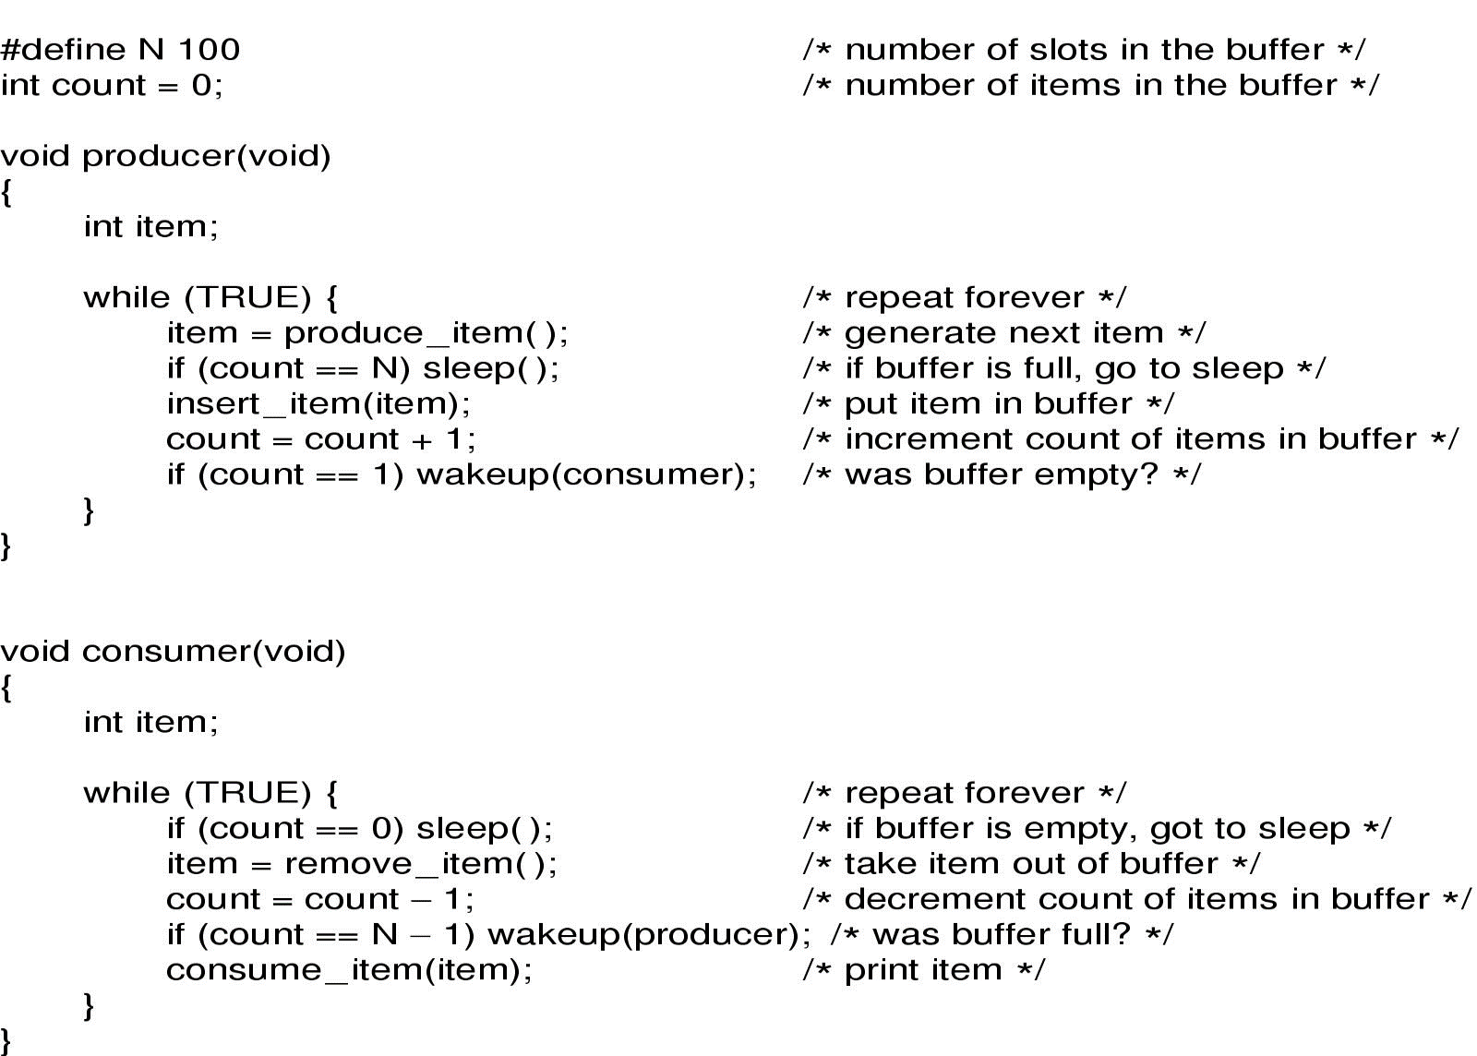
Sleep and Wakeup

Slide 26
Sleep and Wakeup: Race condition
Race condition
Unconstrained access to count
CPU is given to P just after C has read count to be 0 but not yet gone to sleep.
P calls wakeup
Result is lost wake-up signal
Both will sleep forever

Slide 27
Semaphore
Synchronization tool that provides more sophisticated ways (than Mutex locks) for process to synchronize their activities.
Semaphore S – integer variable
Can only be accessed via two indivisible (atomic) operations
wait() and signal()
Originally called P() and V()
Definition of the wait() operation
void wait(sem_t *S)
{
S->value--;
if (S->value < 0)
block on semaphore
}

Slide 28
Semaphore
Definition of the signal() operation
void signal(sem_t *S)
{
S->value++;
if (S->value <= 0)
unblock one process or thread that is blocked on semaphore
}

Slide 29
Semaphore Usage
Counting semaphore – integer value can range over an unrestricted domain
Binary semaphore – integer value can range only between 0 and 1
Same as a mutex lock
Can solve various synchronization problems
Consider P₁ and P₂ that require S₁ to happen before S₂
Create a semaphore “synch” initialized to 0
P1:
S₁;
signal(synch);
P2:
wait(synch);
S₂;
Can implement a counting semaphore S as a binary semaphore

Slide 30
Semaphore
Operation “down”:
if value > 0; value-- and then continue.
if value = 0; process is put to sleep without completing the down for the moment
Checking the value, changing it, and possibly going to sleep, is all done as an atomic action.
Operation “up”:
increments the value of the semaphore addressed.
If one or more process were sleeping on that semaphore, one of them is chosen by the system (e.g. at random) and is allowed to complete its down
The operation of incrementing the semaphore and waking up one process is also indivisible
No process ever blocks doing an up.

Slide 31
Semaphore
Operations must be atomic
Two down’s together can’t decrement value below zero
Similarly, process going to sleep in down won’t miss wakeup from up – even if they both happen at same time

Slide 32
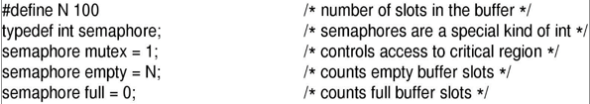
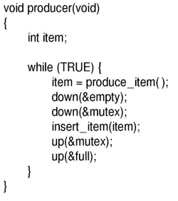
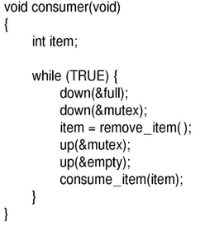
Producer & consumer

Slide 33
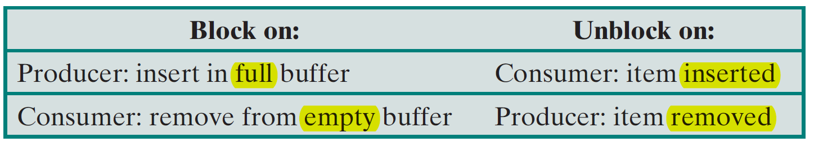
Semaphores in Producer Consumer Problem: Analysis
3 semaphores are used
full (initially 0) for counting occupied slots
Empty (initially N) for counting empty slots
mutex (initially 1) to make sure that Producer and Consumer do not access the buffer at the same time
Here 2 uses of semaphores
Mutual exclusion (mutex)
Synchronization (full and empty)
To guarantee that certain event sequences do or do not occur

